Slide 1
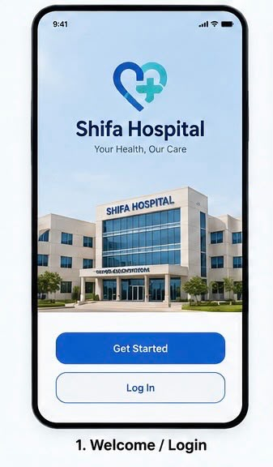
WEEK 6 • MOBILE PROGRAMMING PROJECT
Shifa Hospital
Appointment App
+
A mobile booking experience to help patients find available time slots for a specific doctor.
Team: [6] Members: [Ahmed Tamer, Lana Mohamed, Moahmed Ayman, Abdelrahman Wael, Hala Hassan, Zyad Bassem]
Proposal concept — customer details and requirements to be confirmed with the hospital

Slide 2
1. Identify a Genuine Customer
Customer discovery: organisation, context, and contact
Customer / organisation
Business context
Shifa Hospital
A healthcare organisation providing medical consultations and services to patients.
Patients may need to choose a particular doctor and find a suitable appointment time. Availability can be difficult to check quickly.
Main problem to investigate
Customer contact
It can be hard for patients to find available time slots for a specific doctor. This may cause repeated calls, uncertainty, and extra work for reception staff.
Contact person: To be confirmed
Suggested route: hospital reception or administration through the hospital’s official contact channels.
Interview status: Not yet confirmed.
Note: The problem is the project team’s current understanding and should be validated with a hospital representative.
2

Slide 3
2. The Problem & Opportunity
Why appointment discovery could be easier
Patient challenge
Possible operational impact
Opportunity
• Wants a specific doctor
• Needs a suitable day and time
• May need to call or ask reception
• May not know which slots are available
• Repeated availability enquiries
• Longer booking conversations
• Manual coordination for staff
• Risk of confusion about appointment details
Provide one clear place to view doctor profiles, check available slots, request/book an appointment, and receive confirmation.
Discovery question: Does Shifa Hospital currently face this issue, and how are appointments managed today?
3

Slide 4
3. Proposed Solution
Shifa Appointment App — patient-focused, simple, and practical
A mobile application that helps patients find a specific doctor and view available appointment slots without having to rely only on phone calls or in-person enquiries.
For patients
For reception staff
For the hospital
Search doctors, view specialties and availability, select a suitable slot, and receive booking details.
Reduce repetitive availability questions and make appointment information easier to manage, if supported by hospital workflow.
Offer a more convenient booking journey and a clearer view of appointment requests and confirmations.
Project scope: an initial student prototype focused on appointment discovery and booking—not a replacement for the hospital’s clinical systems.
4

Slide 5
4. App Ideas Considered
Choose the option that best solves the customer problem
Idea A — Doctor Booking
Idea B — Hospital Staff Management
Idea C — Hospital Inventory Management
Find a doctor, view available slots, and book an appointment.
Helps hospital managers organize staff shifts, assign tasks, and manage schedules
Helps hospital track medical supplies and equipment and stock levels
Recommended starting point: Idea A
It directly targets the stated difficulty of finding time slots for a specific doctor. Directory and reminder functions can be included only if time allows.
5

Slide 6
5. Features & MVP Priorities
Build the essential booking journey first
Must have — MVP
Nice to have — later
• Browse/search doctors
• View doctor profile and specialty
• View available dates and time slots
• Select a slot and submit a booking
• Show booking confirmation/details
• Basic appointment management for authorised staff (prototype scope)
• Appointment reminders
• Filter by specialty
• Cancel/reschedule requests
• Favourite doctors
• Multilingual interface
• Integration with hospital systems (only with approval and technical access)
Availability must be accurate and maintained by an authorised source; the prototype can use sample data until approved access exists.
6

Slide 7
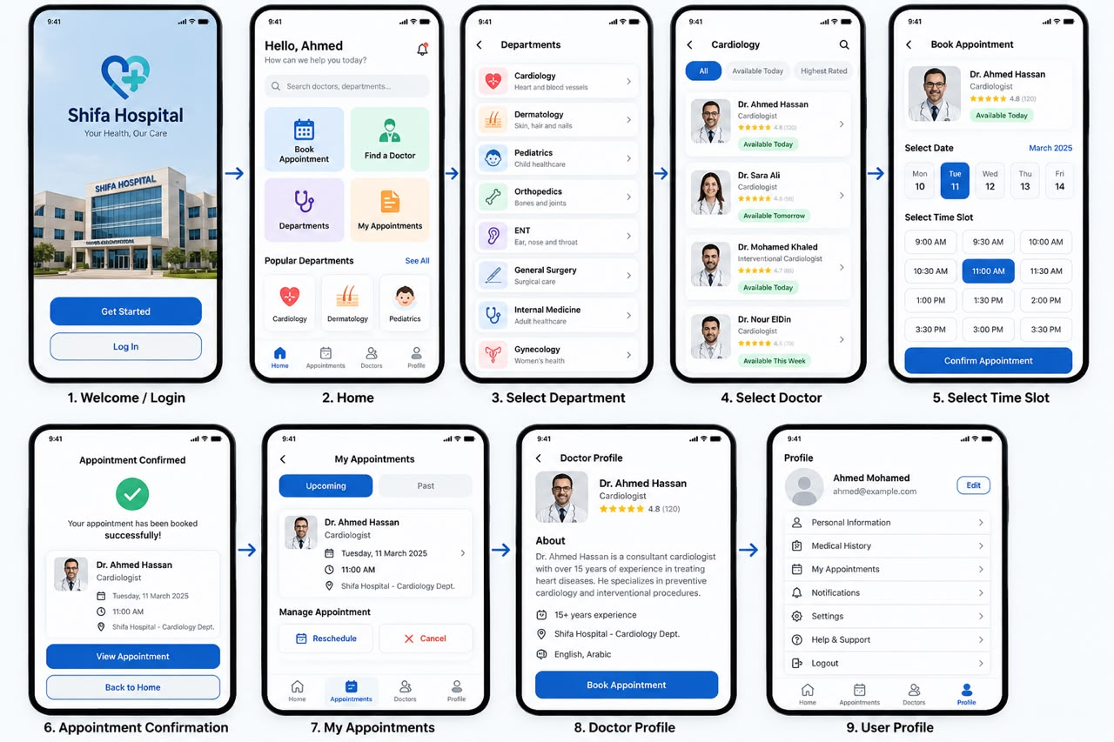
6. Main User Journey
A clear path from opening the app to confirming a visit
1
→
2
→
3
→
4
→
5
→
6
Open app
Search / select doctor
View available slots
Choose date & time
Enter booking details
See confirmation
7

Slide 8
7. Initial Screen Design Plan
At least four labelled screens and their navigation
01 • Welcome / Login
02 • Home / Doctor Search
03 • Doctor Profile & Slots
Sign in or continue to doctor search.
Search by doctor name or specialty.
See doctor details, dates, and available times.
04 • Booking Details
05 • Confirmation
Confirm selected slot and enter required details.
Display appointment reference, doctor, date, and time.
Navigation: Welcome → Home/Search → Doctor Profile & Slots → Booking Details → Confirmation
8

Slide 9
8. Validate the Need with Shifa Hospital
Questions for a short customer interview
• How do patients currently book appointments with a specific doctor?
• How do patients find out which dates and time slots are available?
• What is the most difficult part of the current booking process?
• Who updates the doctor’s availability, and how often does it change?
• What information should patients see before booking?
• Would the hospital be willing to review a student prototype?
Ethical note
Ask permission before naming staff or sharing contact details. Do not collect patient medical records or sensitive health information for this student project.
9

Slide 10
9. Development Plan & Success Criteria
A realistic plan for a semester prototype
Phase 1 — Discover
Phase 2 — Design
Phase 3 — Prototype
• Contact hospital representative
• Interview staff
• Confirm workflow and requirements
• Define MVP
• Draw four or more wireframes
• Review navigation with users
• Implement core screens
• Test sample booking flow
• Gather feedback and improve
Success means users can find a doctor, understand slot availability, complete the booking flow, and clearly see confirmation. Real hospital integration requires explicit approval and access.
10

Slide 11
10. Assumptions, Risks & Next Steps
Keep the proposal realistic and safe
Assumptions to verify
Risks & mitigations
• Shifa Hospital is willing to discuss its booking workflow
• Doctor schedules can be represented in a structured way
• The hospital can identify an authorised contact
• The app should fit existing hospital processes
• Outdated slots: define who updates availability
• Double booking: validate slot status before confirmation
• Privacy: collect only necessary booking data
• Integration limits: use mock data for the student prototype unless approved
Immediate next step: arrange a short interview and replace assumptions with confirmed customer evidence.
11

Slide 12
Thank You
Shifa Hospital Appointment App
Making it easier for patients to find a suitable time slot with the doctor they need.
Team: [Team Name] | Members: [Names & Student IDs] | Contact person: To be confirmed

